Slide 1
Case #1 Regina V. Mitchell
November 24, 1991 – Roxanne Andrews was house sitting at 1352 Juniper Street in Williams Lake.
The person who killed her committed the crime of murder.
She died after being stabbed twenty-five times.

Slide 2
Case #1 Regina V. Mitchell
March 31, 1991 – Cleo Sims was conducting an open house for prospective buyers at 1575 Midnight Drive in Williams Lake.
The person who killed her committed the crime of first degree murder.
She died after being stabbed twenty-two times, and there was evidence that she was sexually assaulted.

Slide 3
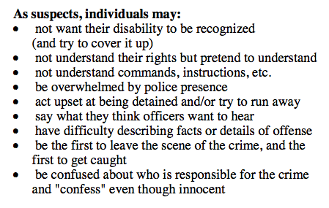
Case #1 Regina V. Mitchell
Travis Mitchell, the man accused of the murders of Roxanne Andrews and Cleo Sims, does not admit that he killed either woman.
The accused is a youth of sub normal mental capacity.
The police arrested him on another charge and asked him if he understood the rights just read to him. He said that he did not understand but they continued to interrogate him.
The police did not tell Mr. Mitchell that he was being detained for the murders nor did they advise him of his right to consult counsel.
How might the actions of the police affect the outcome of this case? Predictions?

Slide 4
PROBLEMS ENCOUNTERED BY DEVELOPMENTALLY DISABLED DEFENDANTS IN THE CRIMINAL JUSTICE SYSTEM
‘Developmentally disabled people may be more likely than non-developmentally disabled people to exhibit characteristics, or experience social and economic conditions, that have been generally associated with criminality, such as low self esteem, poverty (Endicott, 1991), and a lack of social skills (Davis, 2002).’
‘They may also be more susceptible to nonphysical coercion during interrogation. For example, developmentally delayed defendants may find comfort in the appearance of friendliness designed to induce confidence and cooperation.’
‘The act of confessing is further complicated, in the case of developmentally disabled defendants, as the confession process assumes an understanding of Charter rights. (Everington & Fulero, 1999).’
Developmental Disability, Crime, and Criminal Justice: A Literature Review
Simon Fraser University

Slide 5
Relevant Issues:
Quality and reliability of evidence.
How do we determine levels of competence and mens rea?
How do we determine if someone has understood their rights?
How is mental illness comparable to developmental disability?
Medically?
Legally?
Socially?

